Slide 1


KWAME NKRUMAH UNIVERSITY OF SCIENCE AND TECHNOLOGY
KUMASI, GHANA
COLLEGE OF ENGINEERING
DEPARTMENT OF COMPUTER ENGINEERING
DESIGN OF AN 8 BIT MICROPROCESSOR
KWAME NKRUMAH UNIVERSITY OF SCIENCE AND TECHNOLOGY
COLLEGE OF ENGINEERING

Slide 2
OUTLINE
Requirements for the Design
Microprocessor Circuit
    Memory
    Control Unit
    Arithmetic Logic Unit
    Register Bank
Conclusion

Slide 3
Requirements for the Design
1. RAM 2. ROM 3. Decoder 4. Counter
5. Multiplexers 6. Logic Gates: AND, OR, NOT etc…
6. Clocks 7. Tunnels 8. Grounds 9. Registers
10. Splitters 11. Buses 12. Adder
13. Substractor 14. Multiplier 15. Divider

Slide 4
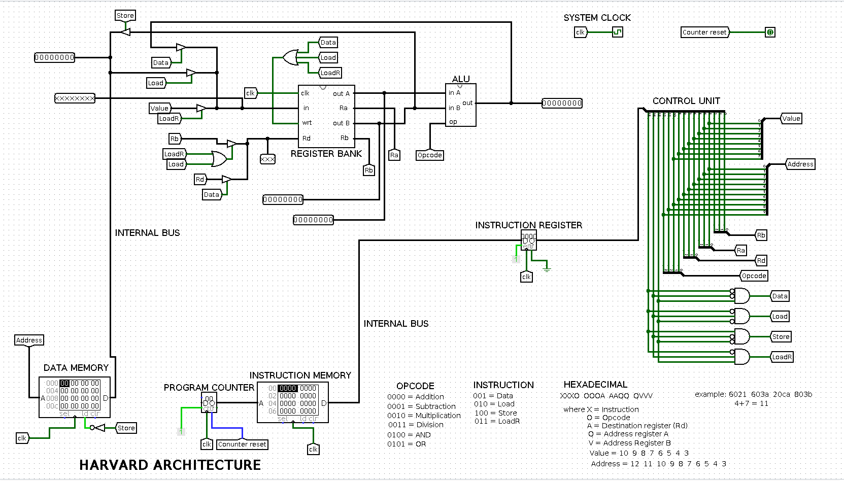
Microprocessor Circuit

Slide 5
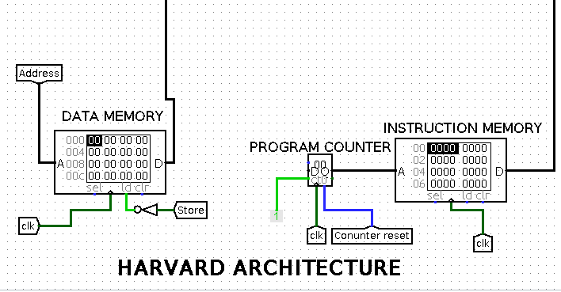
Memory
This memory unit is designed from the Harvard Achitecture

Slide 6
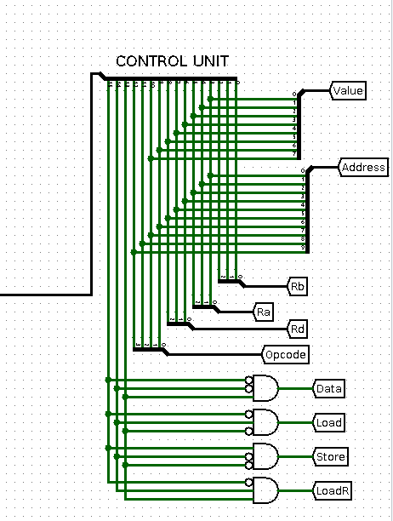
Control Unit
It decodes the instructions from Instruction Register into commands.

Slide 7
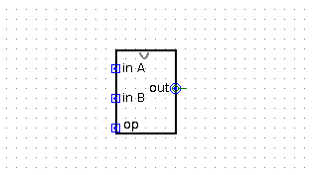
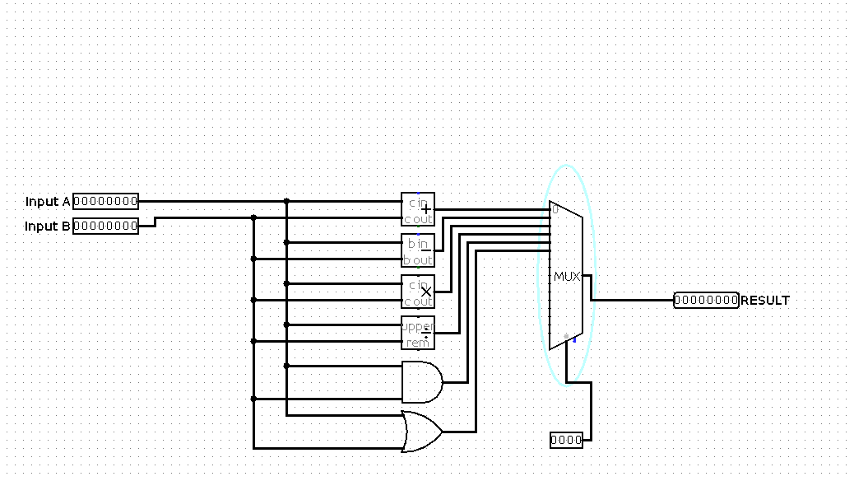
Arithmetic Logic Unit
The ALU does all the arithmetic operations based on the commands from the Control Unit.
Circuit Diagram
Logic Diagram
It has two inputs together with an opcode input and one output. The ALU can currently do addition, substraction, multiplcation, division, ANDing and Oring.

Slide 8
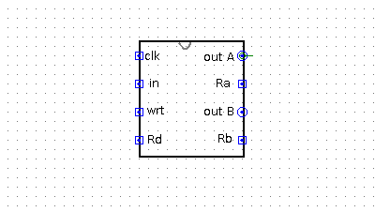
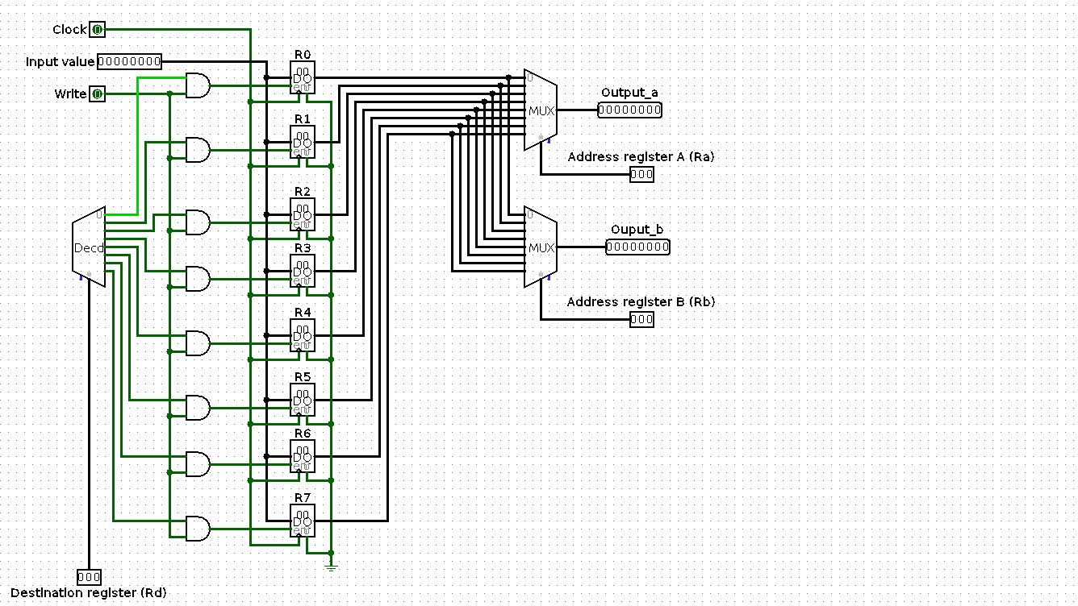
Register Bank
The register bank contains eight(8) different registers for temporary storage of data.
Circuit Diagram
Logic Diagram
It has four different inputs which includes clock, input value, write input and a destination register input. It has four different outputs where each pair represents a value and the address of the register the value is taken from.

Slide 9
Conclusion
Microprocessor comprises of different components which includes memory, control unit, ALU, registers, buses, clock etc…
All of these components work hand in hand in order to produce the desired output from an input and/or store the output for future use.

Slide 10
THANK YOU

